Slide 1






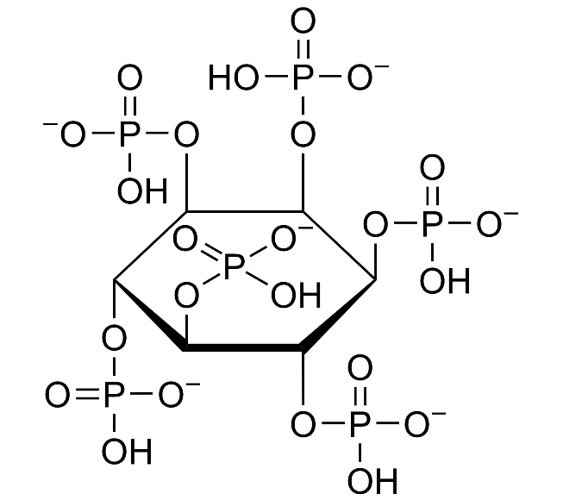

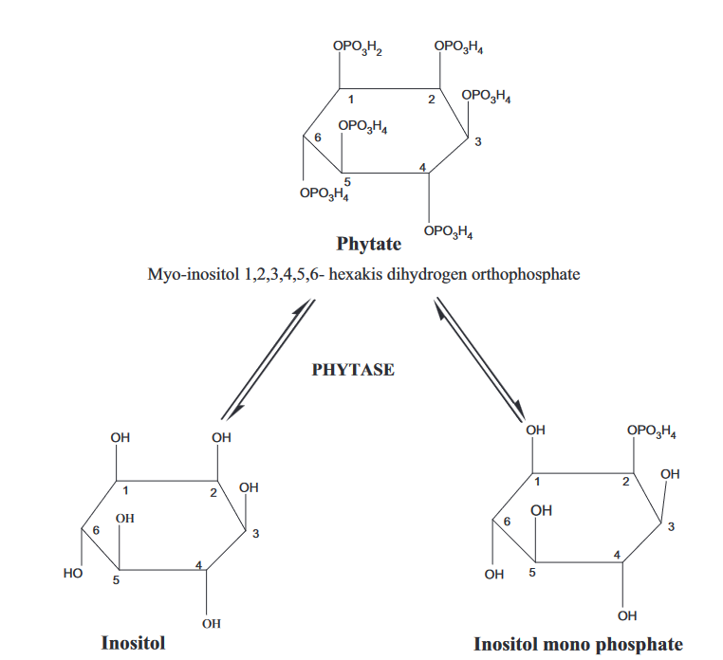
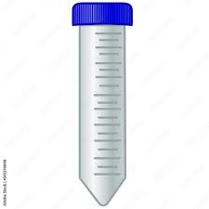
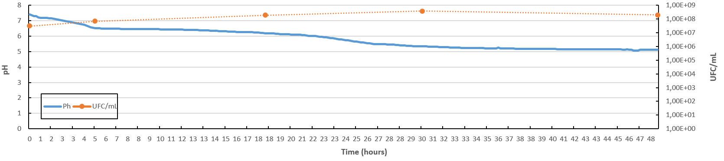
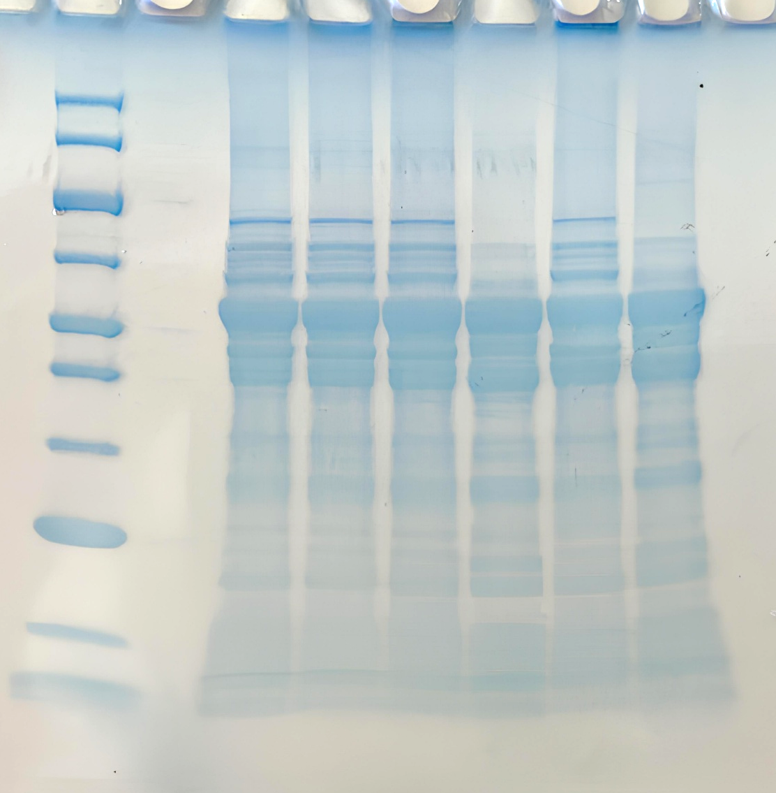
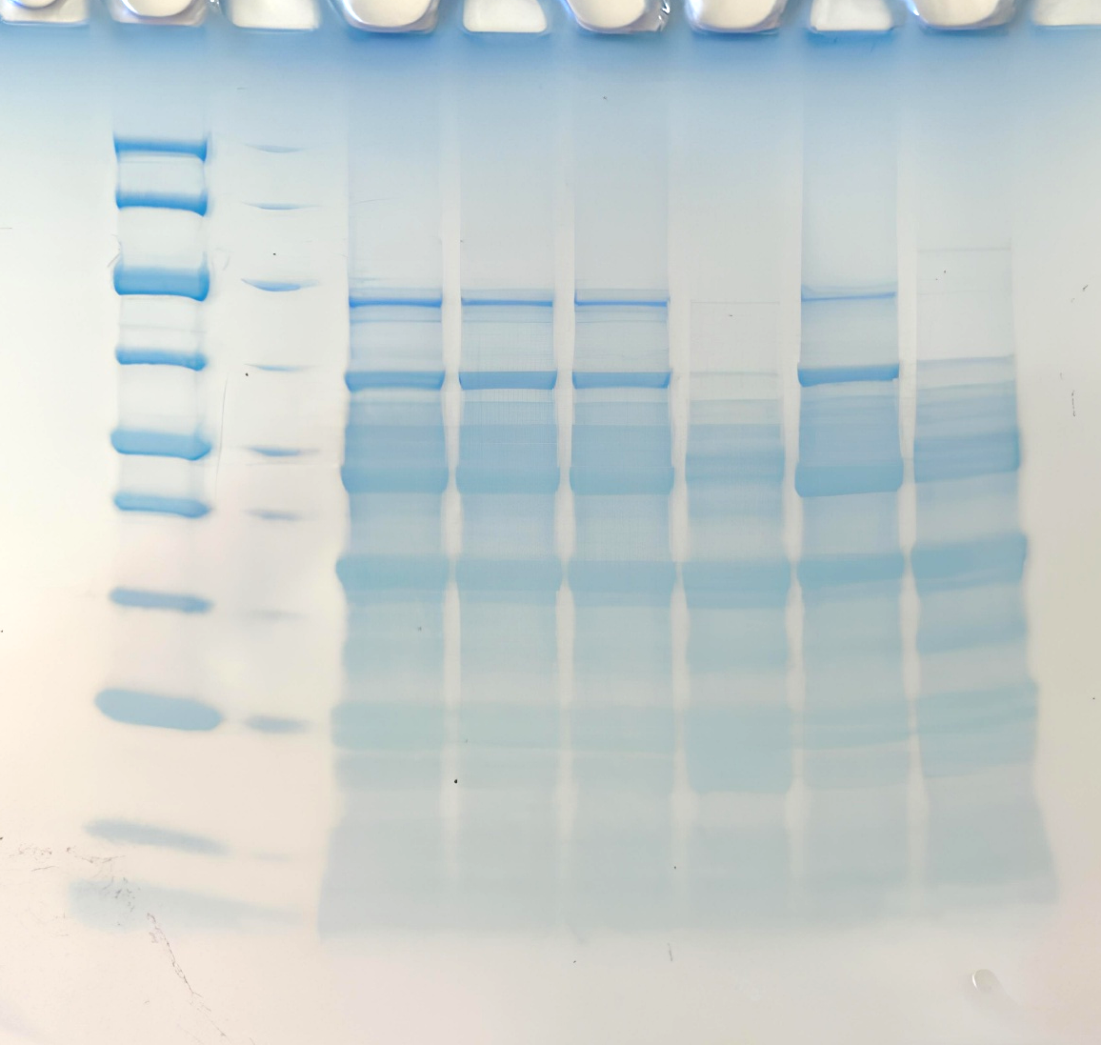
Phytase activity during lactic acid fermentation: Kinetics and impact on protein solubility
Pereyron Valentin¹, Saurel Rémi¹ , Husson Florence¹
¹UMR PAM, Institut Agro DIJON, INRAE, 1 Esp. Erasme 21000 DIJON
Introduction
Legume protein concentrates, such as fava bean protein concentrate, are interesting ingredients for formulating plant-based food products. However, phytic acid, a plant-related molecule, can be found in concentrations of up to 4% (w/w DW basis). This molecule can interact with proteins, impacting their solubility and functionality.
Figure 1 : Phytic acid
Fermentation can be used to remove phytic acid through the action of lactic acid bacteria that produce phytase, an enzyme capable of hydrolysing phytic acid (Figure 2).
Phytic acid (Figure 1) is the storage molecule for phosphate in legume seeds. It is soluble over a wide pH range. Due to its negative charges, it acts as a chelating agent, binding directly to proteins or via the action of bivalent cations (1, 2, 3). These interactions reduce the solubility and availability of proteins.
This work aims to explore fermentation conditions that reduce phytic acid content and study their effect on protein solubility.
Figure 2 : Phytase hydrolytic mecanism (4)
Experimental design
Fermentation and phytase treatments
Protein extract
LAB
Incubation 48h at 37°C
Growth by count plating
Dispersion of Fava Bean concentrate at 10% (w/w) in distilled water, pH ajusted at 7.5
Fermentation
Protein extract
Sample
10,000 x 20min
Supernatant
Protein content, protein profile and phytic acid
Sampling at 5h, 18h, 30h and 48h
Pellet
Bacteria elimination and freeze dryed
LAB Strain
Limosilactobacillus fermentum CIP 102980
4°C overnight under stirring
pH monitoring with automatic sampler during fermentation
Centifugation at 10,000g x 20min
Phytase treatment
2U/35mL (~1U/50mg phytic acid)
Sampling at 1h, 3h and 5h
Phytic acid content (K-PHYT Megazyme)
Soluble protein extract
Protein extract
pH ajusted at 5
Incubation 55°C
Lyophilisation for solubility analysis
Filtration at 0,2µm
Fermentation / phytase treatments
Enzyme : Phytase from Wheat (Sigma, 0,01U/mg, optimal conditions pH 5/ 55°C
Results
Acidification and growth kinetics
Protein profile
Non reducing condition
Pellet
Fermentation
Reducing condition
M
5h
Supernatant
48h
M
Supernatant
Pellet
250
18h
30h
30h
48h
250
5h
18h
30h
48h
30h
48h
150
150
A1
S1
A2
S2
100
Lox
100
70
Lmin
70
Cv
50
Lmax
50
40
V
40
Lα
30
30
Acidification is a two-step process involving two phases (A1 and A2). A static phase can be observed between A1 and A2, particularly during the final stages of fermentation. These patterns of growth and acidification kinetics correspond to diauxie behaviour, where a switch of sugar source occurs during fermentation.
20
20
Lβ
10
Al
10
5
5
Phytic acid reduction and protein solubilty
The protein profile of the supernatant remained unchanged until 48 hours of fermentation and a pH of approximately 5. At this point, it appeared that Lox, Lmin and Cv had precipitated, as could be seen in the control acidification.
Table 1: Phytic acid réduction after phytase treatment (0U : not inoculated with enzyme)
Solubility
Phyase treatments | Reduction of phytic acid (%)
0U | 1,06±0,69
2U-1h | 36,97±2,36
2U-3h | 63,39±2,33
2U-5h | 75,83±0,71
Phytic acid reduction by fermentation or purified enzyme
The solubility curves of the non-fermented and fermented samples are very similar. No significant differences were observed within the tested pH range.
There was no reduction in phytic acid before 30 hours of fermentation.
The maximum reduction was almost 7% after 48 hours of fermentation.
Phyatse treatment allows a phytic acid redcuction of 37% in 1h, 63,4% in 3h and 75,8% in 3h
Phytase treatment has a dual effect on protein solubility. When the pH is above 5.5, a reduction in phytic acid correlates with a significant decrease in solubility, however, no differences between phytase treatments are observed. This means that the effect is complete when the reduction in phytic acid content is at least 37%. Below pH 5, reducing phytic acid significantly improves solubility, reaching a maximum of 91.1% at pH 3.5 for the 2U-5h treatment.
The 3h and 5h treatments show similar solubility curves due to their close phytic acid reduction levels. As can be seen, increasing the reduction of phytic acid greatly improves solubility at pH 4.5, when this effect is less important for pH 4 and 3,5.
A significant reduction in solubility at pH above 5.5 is observed in the 0U condition (no enzyme), which could be a side effect of the treatment conditions (55°C/5h).
Figure 3 : Phytic acid réduction during the fermentation
Table 2: Protein solubility at acid pH (3,5-4,5). Mean of triplicate acidification. Tukey HSD(p<0,05). Each pH is analysed separatly.
pH | PE | PEf | 0U | 2U-1h | 2U-3h | 2U-5h
3,5 | 11,1±1,44 c | 15,5±3,01 c | 10,73±2,73 c | 73,87±2,28 b | 81,80±2,13 ab | 91,1±3,02 a
4 | 9,3±1,50 c | 16,6±3,29 c | 9,67±2,85 c | 65,13±3,54 b | 77,04±4,07 ab | 87,7±4,48 a
4,5 | 14,3±0,44 cd | 18,6±2,00 bc | 10,01±3,73 d | 23,00±0,46 bc | 47,46±2,30 a | 52,2±1,52 a
Figure 4 : Solubility curve obtains after fermentation or phytase tratment. Means of triplicate acidifications (PE: Non treated protein extract, Pef : Fermented protein extract, 0U : Protein extract incubated without enzyme, 2U : Protein extracted incubated with enzyme (1h, 3h or 5h)
Conclusion/Discussion
Perspectives
Based on growth and acidification kinetics, L. fermentum CIP 102980 can ferment the protein extract well using the different types of sugar available.
Phytic acid reduction occurred only during the final 18 hours of fermentation, which corresponded to the second static phase.
Reducing phytic acid impacts the solubility of proteins across the entire tested pH range, with the effect being proportional to the level of reduction. The effects observed at pH levels above 5.5 appear to be due not only to the reduction of phytic acid, but also to the treatment conditions. The low reduction of phytic acid (~7%) through fermentation does not significantly improve solubility.
Reducing phytic acid limits possible interactions with proteins. However, while these interactions reduce solubility at an acidic pH, they are beneficial at a pH above 5.5.
The next step is to observe the behaviour of phytic acid during simulated acidification and after our treatments, in order to confirm that the modifications to solubility are correlated with less interactions between phytic acid and proteins.
During fermentation, lactic acid bacteria can develop proteolytic activities. Protein degradation can affect protein solubility and the way proteins interact with phytic acid. The second part of the study will examine these impacts and attempt to determine which activities have the greatest impact depending on the pH.
This work was supported by the French Agence Nationale de la Recherche (ANR) and took part during a national project focused on fava bean study called Lestproseed.
(1) J.R.Brooks and C.V. Morr, Journal of Food Science, 1982, 10.1111/j.1365-2621.1982.tb07666.x
(2) R.Wang and S.Guo, Comp Rev Food Sci Food Safe,2021, 10.1111/1541-4337.12714
(3)T.Amat,A.Assifaoui,J.Buczkowski,J.V.C.Silva,C.Schmitt,R.Saurel, Food Hydrocolloids,2024, 10.1016/j.foodhyd.2023.109273
(4) Vikas Kumar and Amit K. Sinha, Enzymes in Human and Animal Nutrition, 10.1016/B978-0-12-805419-2.00003-4

